Slide 1

XYZ
Chabot Solution
1/9

Slide 2
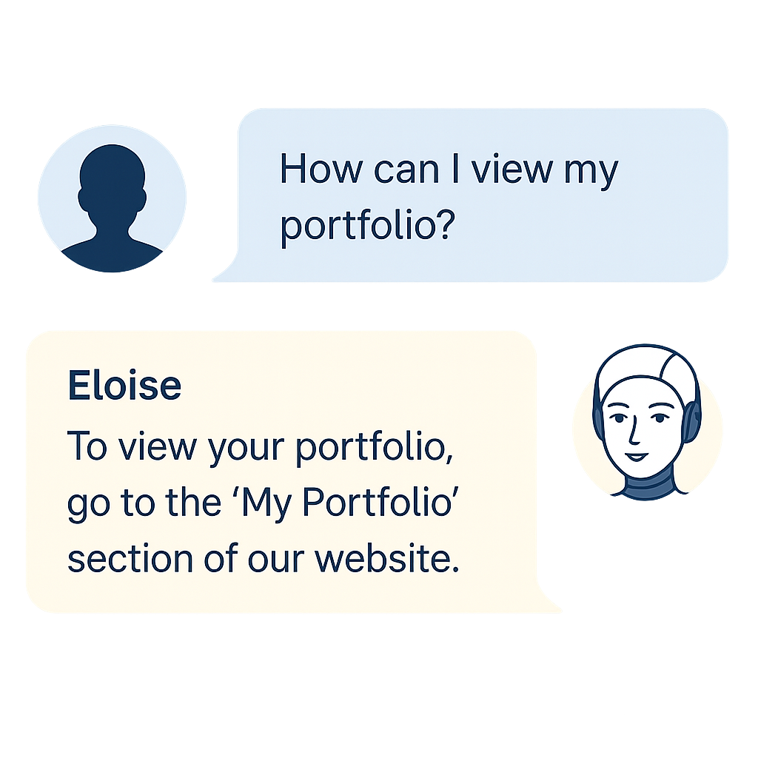
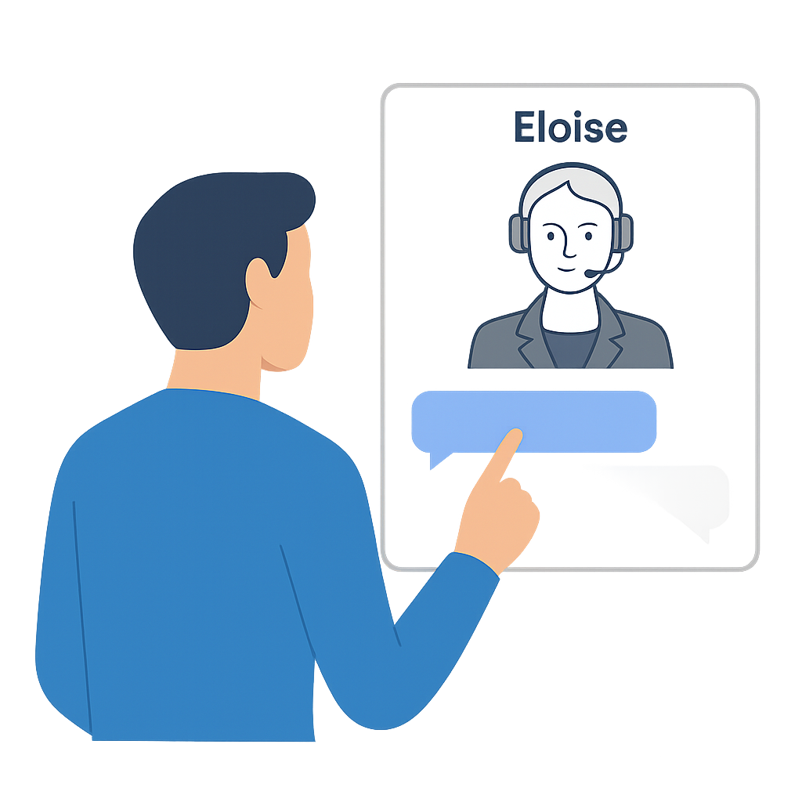
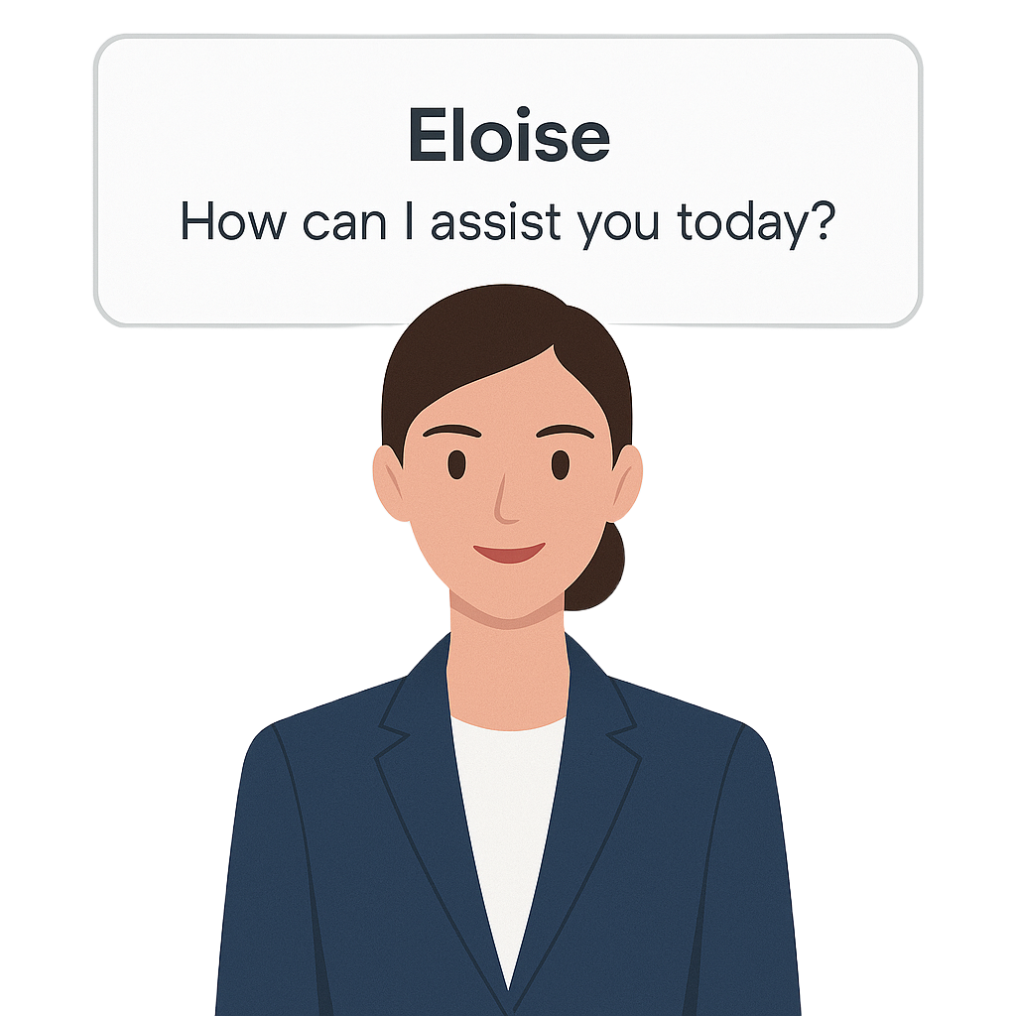
Solution - ‘Eloise’ AI service assistant
2/9

Slide 3










Customer Experience Journey
Customer • Wealthy clients want fast, digital service but rely on human advisers for complex issues.
Profile • Business professional / owner, time-constraint, security-conscious.
Top Customer • Instant, accurate & personalised information, privacy and security.
Needs • Clear and tailored guidance on financial planning, fast escalation to agent.
1. Discovery
2. Query & Retrieval
3. Resolution & Guidance
4. Follow Up / Closure
Customer Activities
Lands on portal
Sees chat widget
Types questions
Clicks on suggestions
Reviews Answer
May probe deeper
Closes chat
Rates experience
Happy
Customer Feelings
Engaged
Optimistic
Satisfied if accurate
Relived
Frustrated if not accurate
Disappointed
Fails to load
Frustrated
Curious
Somewhat Cautious
Sad / Frustrated
Internal Processes
SSO Authentication
Widget Load
RAG Retrieval
Policy Check
Confidence scoring
Human-fallback
Archive Transcript
Trigger Survey
Opportunities
Proactive Greeting
Quick Start Tips
Show suggested replies
Link to FAQs
Offer related content
Promo adviser consult
Gather feedback
Update KB

Slide 4























Build Vs Buy Scorecard
Perspective
Requirement
Weight %
Build
Buy
FCA Compliant.
Know Your Customer (KYC).
GDPR.
Anti-Money Laundering (AML).
Higher burden of ongoing controls & review.
Requires full compliance implementation.
Manual PII redaction, audit trail, versioning.
Compliant Ready.
Terms & Conditions reviewed.
Built-in audit longs and role-based access.
Regulation
25%
End-To-End Encryption.
Audit Trails and Backups.
PII redaction.
Customer trust and privacy.
Manual integration of Encryption.
Set up log storage and backups servers.
Encrypted by designed.
vendor certified.
Risk of vendor breach or malfunction.
Security
25%
User Experience
Intuitive Design.
UX escalation pathway.
Responsive and Accurate.
20%
Hyper personalized experience.
Requires full UI build and design QA.
Slow development.
Limited branding customisation.
Tested front-end UX.
Fast time to MVP.
Compatible with existing. Infrastructure.
Provides batch or real-time. Services.
Full API control over sensitive systems.
Integration Complexity.
Needs secure API gateway and sandbox testing.
Plug and Play connectors for common CRMs.
Higher costs for custom integrations and usage.
Integration
10%
Hallucination control.
High-quality answers.
Accuracy Testing.
20%
Risk of hallucination without third-party oversight.
Full control over RAG and retraining.
Built in around internal data sources.
Limited internal tuning.
Tuned models for Financial use cases.
Confidence scoring and fallback built-in.
Reliability
Weighted Score:
100%
35%
65%
4/9

Slide 5
























Development & Implementation
Q1
Q2
Q3
Q4
Market Discovery
Contract Negotiation
SaaS Solution
Vendor Due-Diligence
On-boarding
Product Specifications
Internal Web Portal MVP
Mobile App SDK
Develop MVP
Intent Taxonomy & Training Data
WhatsApp Integration
Voice IVR Integration
Staged Rollout
Omnichannel Launch
Launch
Ongoing Testing
KPIs Development & Tracking
Colour legend 🟠Compliance 🔴 Security 🔵 Performance 🟢 Experience 🟣 Integration
Integration
Compliance
Experience
Security
Performance

Slide 6
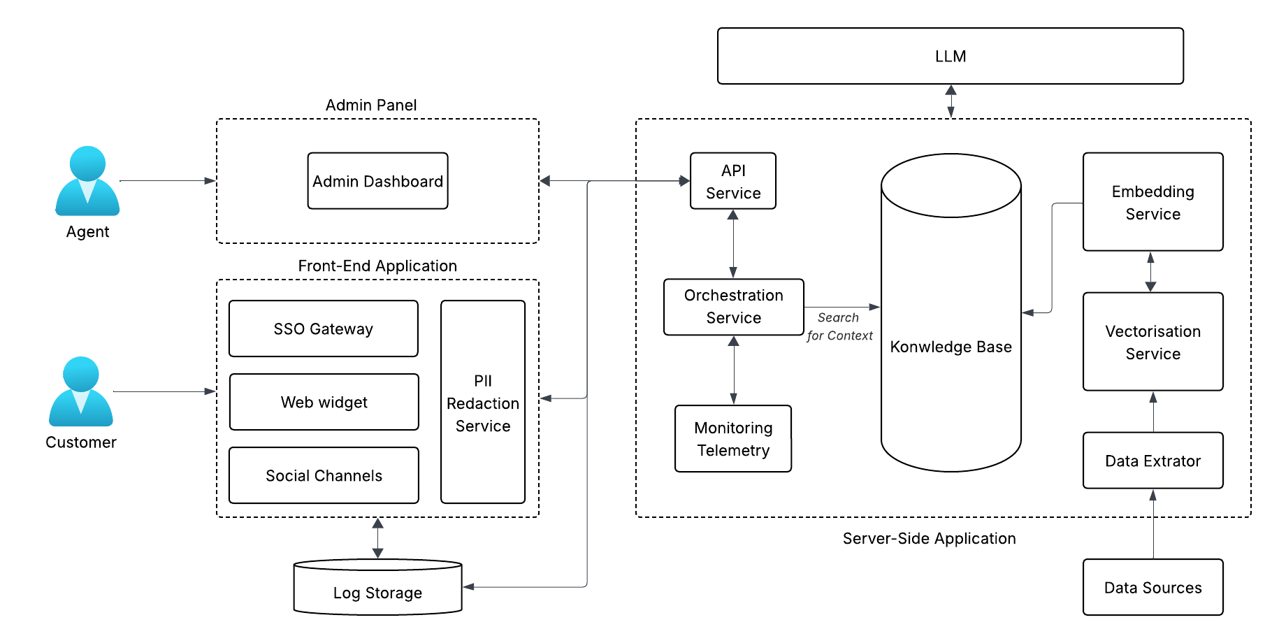
‘Eloise’ Architecture – RAG Framework
6/9

Slide 7











































Risk Register & Mitigation Strategies
Risk
Impact
Likelihood
Mitigation
1
Hallucinated Guidance
High
Medium
RAG-Grounded answers
Confidence Gating
Human Fallback
2
Data Exfiltration
High
Low
End-To-End Encryption
PII Redaction Service
Regular Pentesting
3
Regulatory Breach
High
Medium
Policy engine blocks advice prompts
Immutable audit logs
4
Integration Failure
Medium
Medium
Sandbox testing
Circuit Breaker
Delta-feed for freshness
5
Batch-latency Personalisation
Medium
Medium
24hr cache
Hourly delta feeds
6
Medium
Medium
Exit Clauses & Data Export
Dual-vendor PoC
Vendor Lock-in
Medium
Medium
Phased Pilot & Incentives
Adviser Workshops
7
Low Adoption
Escalation button
Beta soft-launch
PR response plan
8
High
Low
Reputation Risk

Slide 8
Q&A
8/9

Slide 9
References
Ada (2025). The Road Ahead for AI Customer Service. [online] Www.ada.cx. Available at: https://www.ada.cx/blog/the-road-ahead-for-ai-customer-service/.
AI Business (2022). Pros and Cons of Buying vs. Building AI. [online] Aibusiness.com. Available at: https://aibusiness.com/verticals/pros-and-cons-of-buying-vs-building-ai.
EY (2025a). How Can Wealth Managers Transform Customer experience? [online] Ey.com. Available at: https://www.ey.com/en_uk/insights/wealth-asset-management/how-can-wealth-managers-transform-customer-experience.
EY (2025b). Should Organisations Buy AI Systems or Build them? [online] Ey.com. Available at: https://www.ey.com/en_ie/insights/ai/should-organisations-buy-ai-systems-or-build-them.
Fokina, M. (2024). 10+ Crucial AI Customer Service Statistics [2024 Data]. [online] Tidio. Available at: https://www.tidio.com/blog/ai-customer-service-statistics/.
Gartner (2022). Gartner Predicts Conversational AI Will Reduce Contact Center Agent Labor Costs by $80 Billion in 2026. [online] Gartner. Available at: https://www.gartner.com/en/newsroom/press-releases/2022-08-31-gartner-predicts-conversational-ai-will-reduce-contac.
htec (2025). Revolutionizing AI customer support with RAG chatbots | HTEC. [online] HTEC. Available at: https://htec.com/insights/blogs/revolutionizing-ai-customer-support-with-rag-chatbots/
HubSpot (2024). 2023 AI Trends for Marketers | HubSpot. [online] offers.hubspot.com. Available at: https://offers.hubspot.com/ai-marketing.
PwC (2024a). Asset and Wealth Management Revolution 2024 | PwC Global. [online] PwC. Available at: https://www.pwc.com/gx/en/issues/transformation/asset-and-wealth-management-revolution.html.
PwC (2024b). Regulators Outline AI Priorities for next 12 Months. [online] PwC. Available at: https://www.pwc.co.uk/industries/financial-services/understanding-regulatory-developments/regulators-outline-AI-priorities-for-next-12-months.html.
Raj Neervannan (2024). In-House or Off-The-Shelf? a C-Suite Decision Framework for Buying Vs. Building an AI Model. [online] Forbes. Available at: https://www.forbes.com/councils/forbestechcouncil/2023/12/13/in-house-or-off-the-shelf-a-c-suite-decision-framework-for-buying-vs-building-an-ai-model/.
Swift (2024). Know Your Customer (KYC). [online] Swift. Available at: https://www.swift.com/risk-and-compliance/know-your-customer-kyc.
9/9

